Slide 1
Chromebook Classroom Rules
By Mrs. Schwappach

Slide 2
Wait for your Chromebook number or table group to be called.

Slide 3
Handle your Chromebook with extreme caution and care.
Remember these are your tools for the School Year. Treat them as if they were your own.

Slide 4
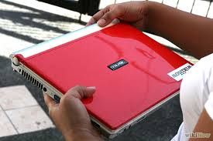
Use BOTH hands to carry it while the screen is closed

Slide 5
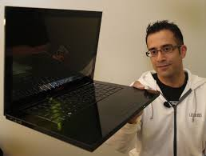
Wrong!

Slide 6
Wrong!

Slide 7
Use it ONLY to conduct research, create projects, and complete class assignments.

Slide 8
5 Minute Rule
You have five minutes to:
Report damage to the Chromebook
Report inappropriate websites/pictures
If you do not report it you will be held responsible for it whether you did it or not. You will suffer the consequences.

Slide 9
Be sure to log out of your Chromebook each day, and return it to the Chromebook cart.

Slide 10
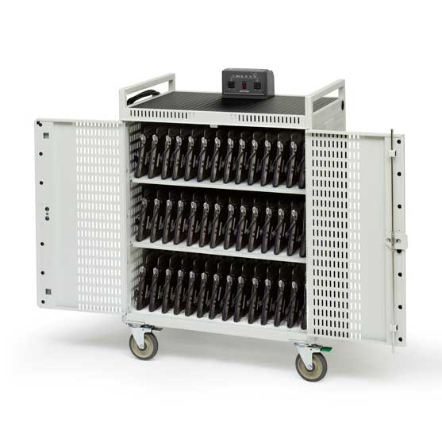
Place your Chromebook in the cart on its matching number with the power plug facing up.

Slide 11
The Don’ts!
Leave it on the ground or stack it on top of books.

Slide 12
The Don’ts!
Do not lean on the computer screen or wiggle the the screen back and forth.

Slide 13
The Don’ts! Do not
Carry it or pass it around with the screen open.

Slide 14
The Don’ts! Do not
Slam on the keyboard or type with dirty hands.

Slide 15
The Don’ts! Do not
Eat or drink near your Chromebook.

Slide 16
The Don’ts! Do not
Go on websites or conduct online searches that are unrelated to the assigned topic.

Slide 17
Consequences
1st offense:
2nd offense:
3rd offense:
4th offense:

