Slide 1
How to save an image on Google Drive

Slide 2
Step One: Go to Chrome

Slide 3
Step Two: Go to Drive
Click the to access your google apps.
Click Google Drive

Slide 4
Click Create
Choose Folder
Name it: Pictures
This is where you will save all your pictures.

Slide 5
Go to Google Search
Click the to access your google apps.
Click Google Search
Click images

Slide 6
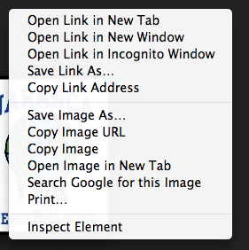
Find an image you would like to save.
Put your curser over the picture you want and push the right black button on your mouse.
This screen will pop up.
Click Save image as.

Slide 7
Rename your image.
Make sure to leave .jpg on the end of the picture if it is there.
Save it to Google Drive, Pictures.

